Slide 1
Dark Ship-to-Ship Transfer Detection Using SAR Imagery and AIS Verification
Presented By
Name of the student Roll Number
P.Ananya 23EG105K02
S.Vinitha 23EG105K08
K.Revanth Kumar 23EG105K23
K.Jaswanth 23EG105K65
Guided by: Padmapriya mam

Slide 2
ABSTRACT
Illegal maritime activities such as sanctions evasion and unregulated cargo smuggling often occur through covert ship-to-ship (STS) transfers, where vessels intentionally disable AIS tracking to avoid detection. Existing approaches rely on AIS alone or costly commercial optical imagery, making them incomplete or inaccessible. This project presents a cost-free system using Sentinel-1 SAR imagery, which sees through cloud cover and darkness. Training labels are generated automatically by matching open AIS data to Sentinel-1 scenes at the exact acquisition time, and a YOLOv8 model detects both vessels and STS transfers directly as a separate detection class. STS detections with fewer than two matching AIS identities are flagged dark and assigned a suspicion score, then cross-checked against Global Fishing Watch's independent global layers, allowing the same trained model to be validated at chokepoints worldwide.

Slide 3
PROBLEM STATEMENT
Ships engaged in illegal activities such as sanctions evasion, oil smuggling, and unauthorized cargo transfers frequently switch off their AIS transponders to avoid being tracked. Current maritime surveillance systems either depend solely on AIS data, which is easily disabled by the very vessels attempting to hide, or on commercial satellite imagery services such as PlanetScope, which are expensive and inaccessible to independent researchers and smaller maritime authorities. There is currently no freely available, end-to-end system that can detect vessels directly from satellite imagery, cross-check them against tracking data, and flag suspicious dark ship-to-ship transfers without relying on paid data sources.

Slide 4
EXISTING SYSTEM
Existing maritime monitoring relies primarily on AIS (Automatic Identification System) tracking, which vessels can legally and easily disable at will. Commercial satellite-based monitoring solutions, such as the PlanetScope-based approach used in prior research, can detect dark ship-to-ship transfers but require paid optical imagery subscriptions. Public benchmark datasets such as xView3-SAR focus specifically on illegal fishing activity rather than general dark-vessel or smuggling detection. As a result, no freely accessible system currently exists that can independently confirm whether a vessel is deliberately avoiding tracking, using only open data sources.

Slide 5
LITERATURE SURVEY
Automatic Detection of Dark Ship-to-Ship Transfers Using Deep Learning and Satellite Imagery — 2024 — Base Paper
Detects dark STS transfers using AIS and PlanetScope optical satellite imagery in the Kerch Strait.
xView3-SAR: Detecting Dark Fishing Activity Using Synthetic Aperture Radar Imagery — 2022
Introduced the open xView3-SAR benchmark dataset for dark-vessel detection in SAR; informs our task framing though our own labels are auto-generated from AIS.
FAD-SAR: A Novel Fishing Activity Detection System via SAR Images Based on Deep Learning — 2024
Benchmarks multiple deep learning object detectors for vessel detection in SAR imagery.
Detecting Intentional AIS Shutdown in Open Sea Maritime Surveillance Using Self-Supervised Deep Learning — 2023
Uses AIS trajectory patterns alone, via self-supervised learning, to detect deliberate tracking shutdowns.
Paolo et al., Satellite Mapping Reveals Extensive Industrial Activity at Sea, Nature — 2024
Global Sentinel-1 SAR vessel detection powering Global Fishing Watch's SAR presence layer, used here as an independent comparison layer, not ground truth.

Slide 6
PROPOSED SYSTEM
The proposed system detects dark ship-to-ship transfers using entirely free data sources. Sentinel-1 SAR imagery is fetched pre-calibrated and tiled. Training labels are generated automatically by matching Danish AIS positions to each tile at the exact overpass time, removing the need for manual labeling. A YOLOv8 model outputs two classes, vessel and sts, since transfers are detected directly as a box around rafted vessels rather than inferred from proximity. False-positive filtering removes SAR artifacts before scoring. Each STS detection is buffered 500m and checked against AIS within ±12 hours; fewer than two matching identities flags it dark, scored by dark duration, sanctioned-zone proximity, and lane deviation. Vessel type comes from Global Fishing Watch's registry for matched detections, and a size estimate for dark ones. Results are cross-checked against GFW's global SAR, gap, and encounter layers and shown on a dashboard; since these layers need no regional AIS, the same model validates at any chokepoint worldwide.

Slide 7
ADVANTAGES
Relies entirely on free, open data sources (Sentinel-1 SAR and open AIS records), removing the high cost of commercial imagery.
SAR imagery enables all-weather, day-and-night vessel detection, unlike optical imagery limited by cloud cover and daylight.
Cross-referencing detected vessels with AIS records reveals ships that intentionally disable tracking to evade sanctions.
Training labels are generated automatically from AIS-to-SAR matching, avoiding costly manual annotation; the lightweight YOLOv8 model offers fast, low-compute detection.
Suspicion scoring based on dark duration, proximity to sanctioned zones, and shipping-lane deviation helps prioritize the most likely illicit events.
An interactive map dashboard supports continuous, scalable monitoring for maritime authorities.
SAR-artifact filtering and GFW cross-checks cut false positives and let the model validate at any chokepoint.

Slide 8
DISADVANTAGES
SAR imagery has coarser spatial resolution than optical imagery, making it harder to precisely resolve individual vessels in close-proximity STS events.
Speckle noise inherent to SAR requires extensive preprocessing, which can introduce artifacts or delay detection.
Sentinel-1's revisit rate is lower than commercial providers, reducing temporal coverage and risking missed transfer events.
Gaps or delays in open AIS data can cause false positives, misclassifying legitimate vessels as dark.
Detection accuracy depends heavily on precise AIS-to-SAR time alignment during label generation. At 10m resolution, vessel type cannot be reliably classified from the image alone, so type is only known for AIS-matched vessels; dark vessels get a size estimate, not a confirmed type.
Suspicion-score thresholds need careful calibration; poor tuning can raise false alarms or miss genuine illicit transfers.

Slide 9
INTRODUCTION (DESIGN)
This presentation covers the design phase of our Dark Ship-to-Ship Transfer Detection System. In this phase, we designed the overall system architecture, workflow, and UML diagrams to define the structure and communication between the data acquisition, preprocessing, detection, verification, and dashboard modules. The design acts as a blueprint for developing the complete pipeline in the implementation phase.

Slide 10
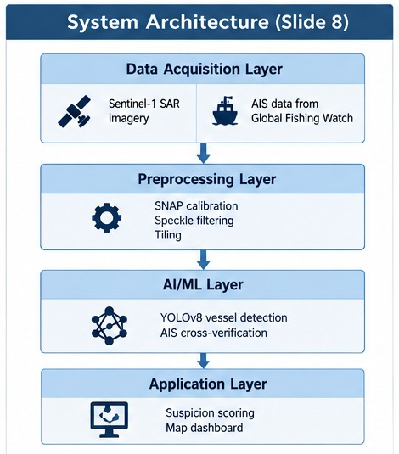
SYSTEM ARCHITECTURE

Slide 11
The System Architecture shows the overall design of the Dark Ship-to-Ship Transfer Detection System. It is a layered pipeline where satellite and tracking data are acquired, processed by AI models, cross-verified, and presented on a dashboard.
Data Acquisition Layer: Downloads Sentinel-1 SAR imagery from the Copernicus Data Space Ecosystem and raw AIS data from the Danish Maritime Authority (for training); Global Fishing Watch's global layers are queried separately for cross-validation.
Preprocessing Layer: Fetches already calibrated, terrain-corrected SAR imagery via the Copernicus Sentinel Hub Process API, then splits it into tiles.
AI/ML Layer: A YOLOv8 model, trained on automatically AIS-derived labels, detects vessels and STS events in SAR tiles; a filtering module removes SAR artifacts, and a cross-verification module compares STS detections against AIS records (and GFW's global layers) to flag dark events.
Application Layer: A map-based dashboard displays flagged dark-ship and ship-to-ship transfer events, ranked by suspicion score.

Slide 12
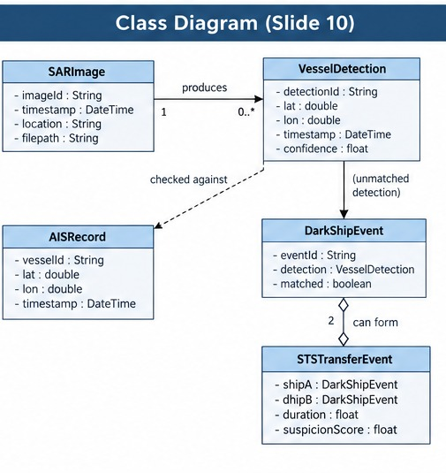
CLASS DIAGRAM
The Class Diagram represents the static structure of the system by showing the major classes, their attributes, operations, and relationships.
The main classes involved in the system are SARImage, VesselDetection, AISRecord, DarkShipEvent, and STSTransferEvent. These classes represent the entities required for satellite image handling, vessel detection, AIS cross-verification, and suspicion scoring.
A SARImage produces one or more VesselDetections; each VesselDetection is checked against AISRecords, and unmatched detections become DarkShipEvents, which may be paired into an STSTransferEvent with an associated suspicion score.

Slide 13
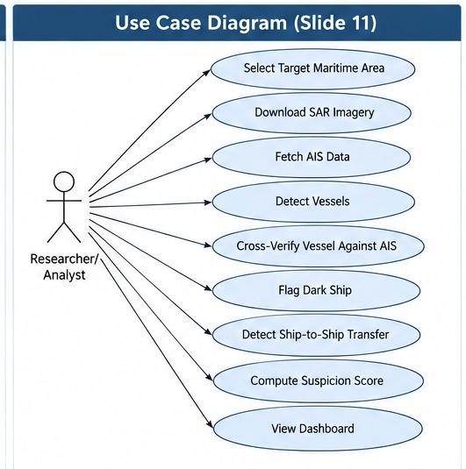
USECASE DIAGRAM
The Use Case Diagram represents the functional interaction between the researcher/analyst and the dark ship detection system. It shows the activities the user can perform, such as selecting a target maritime area, downloading SAR imagery, running vessel detection, fetching AIS tracking data, cross-verifying detections against AIS records, viewing flagged dark ships, reviewing paired ship-to-ship transfer events, and viewing the suspicion-scored map dashboard. The system uses a YOLOv8 detector, an AIS cross-verification module, a suspicion-scoring module, and a dashboard for presenting results.

Slide 14
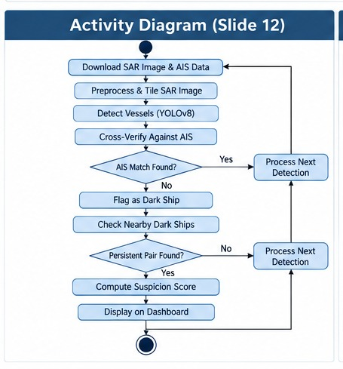
ACTIVITY DIAGRAM
The Activity Diagram represents the complete workflow of the proposed system from data acquisition to the final dashboard display. The process begins when a SAR satellite image and corresponding AIS data are downloaded for the selected maritime area and date range.
The SAR image is preprocessed and tiled, then the YOLOv8 model detects vessels in each tile.
Each vessel and STS detection is cross-verified against AIS records within a time window; STS detections with fewer than two matching AIS identities are flagged dark, false-positive filters are applied, a suspicion score is computed, and results are displayed on the dashboard.

Slide 15
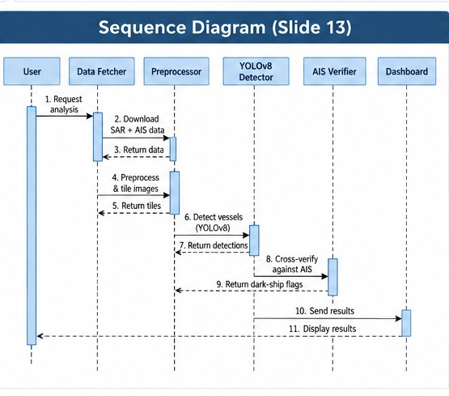
SEQUENCE DIAGRAM
The Sequence Diagram represents the chronological communication between different components of the system. The main participants are the user, the SAR/AIS data fetcher, the preprocessing module, the YOLOv8 detector, the AIS verification module, and the dashboard.
The user requests analysis for a target area; the fetcher downloads SAR imagery and AIS data, the preprocessing module prepares tiles, and the detector returns vessel detections.
The verification module cross-checks each STS detection against AIS records and flags dark STS events; the scoring module computes suspicion scores for these events, and the dashboard displays the final results to the user.

Slide 16
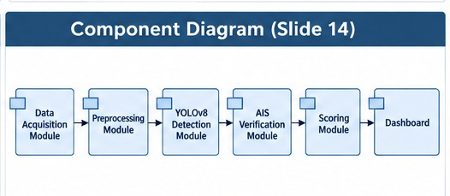
COMPONENT DIAGRAM
The Component Diagram represents the major software components of the system and their dependencies. The main components include the Data Acquisition module, Preprocessing module, YOLOv8 Detection module, AIS Verification module, Scoring module, and Dashboard.
The Data Acquisition module feeds the Preprocessing module, which supplies clean tiles to the Detection module. The Detection module's output is passed to the AIS Verification module for cross-checking.
The Scoring module consumes flagged dark-ship events from the Verification module and computes suspicion scores, which the Dashboard component retrieves and displays.

Slide 17
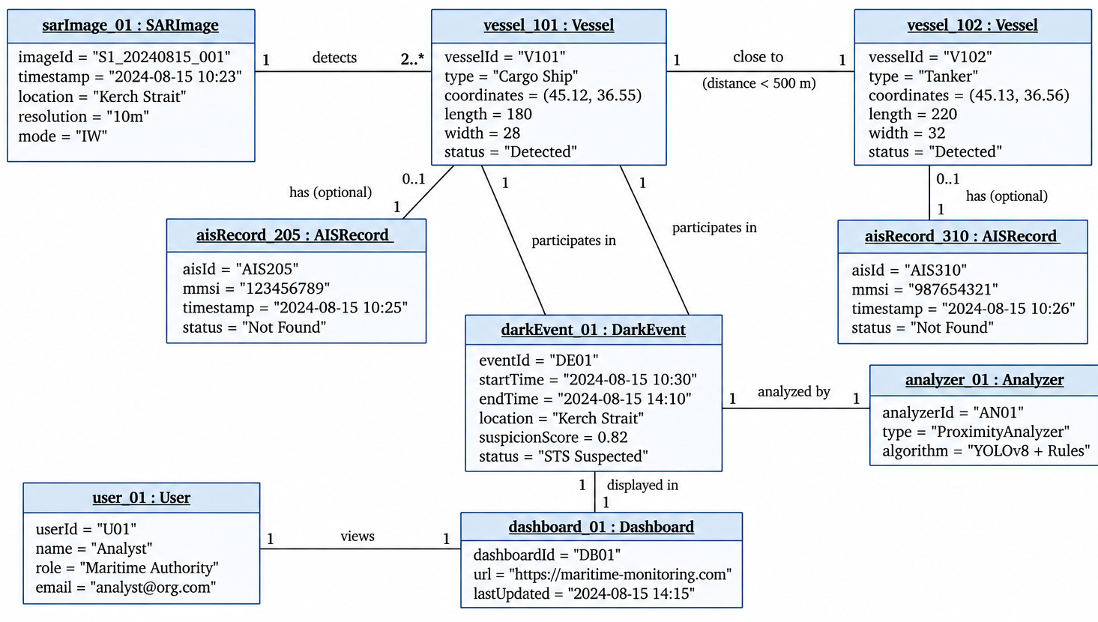
OBJECT DIAGRAM
The Object Diagram represents a snapshot of the Dark Ship-to-Ship Transfer Detection System at a particular point in time. It shows actual instances of SAR images, vessels, AIS records, dark events, analyzer, and dashboard.
The SARImage object contains detected vessel and STS objects; the detector identifies an STS event directly as a single box around rafted vessels, not by pairing two separately-detected vessels. Each detection may have a corresponding AIS record. When an STS detection has fewer than two matching AIS records nearby, it is represented as a dark event.
The dark event is analyzed by the analyzer, assigned a suspicion score, cross-checked against Global Fishing Watch's global layers, and displayed on the dashboard for the user/analyst.
Department of computer Science
15

Slide 18
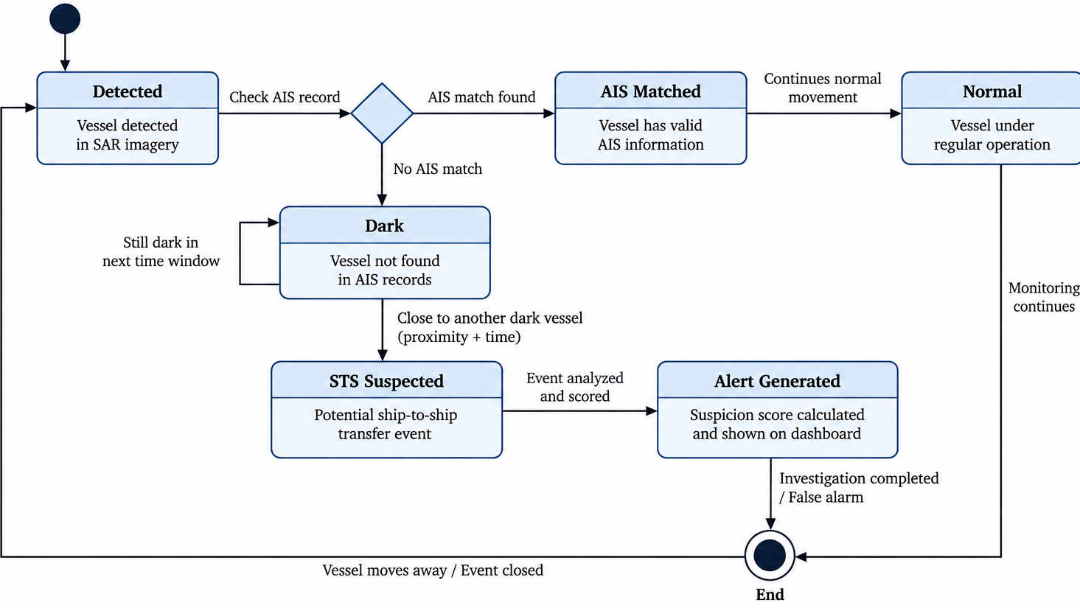
STATE MACHINE DIAGRAM
The State Machine Diagram represents the different states of a detection during the verification process. The process begins when a vessel or STS event is detected directly in Sentinel-1 SAR imagery as its own detection class.
The detection is checked against AIS records within a time window. If two or more matching identities are found, it moves to AIS Matched and continues under normal monitoring. If fewer than two matches are found, it enters the Dark state (and, for a Dark vessel detection specifically, is first passed through false-positive filtering to rule out SAR artifacts).
If the Dark detection's class is STS (already identified by the detector as a rafted-vessel event, not inferred from proximity between two vessels), the state changes to STS Suspected. The event is analyzed, cross-checked against GFW's global layers, scored, an alert is generated, and the event is closed.
Department of computer Science
16

Slide 19
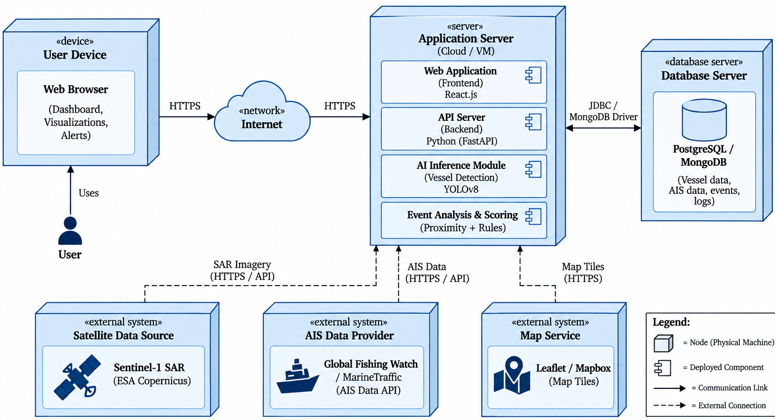
DEPLOYMENT DIAGRAM
The Deployment Diagram represents where the software components of the Dark Ship-to-Ship Transfer Detection System are deployed. It shows the user device, network, application server, database server, and external data sources.
The user accesses the system through a web browser/dashboard over the Internet. The application server hosts the web application, backend API, YOLOv8 vessel detection module, and event analysis and scoring components.
The application server communicates with Sentinel-1 SAR imagery, AIS data providers, and map services through APIs. Detected vessel data, AIS information, events, and logs are stored in the PostgreSQL/MongoDB database.
Department of computer Science
17

Slide 20
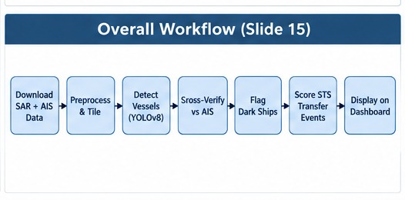
OVERALL WORKFLOW

Slide 21
The Overall Workflow shows how the Dark Ship-to-Ship Transfer Detection System works from raw satellite data to a final flagged result.
Sentinel-1 SAR imagery is fetched pre-calibrated, and AIS is used both to auto-generate training labels (Danish waters) and to verify detections anywhere. The imagery is tiled and passed through a YOLOv8 detector that identifies vessels and STS events as separate classes. Each detection is filtered, then cross-checked against AIS and GFW's global layers; STS events with fewer than two matching identities are flagged dark and scored, displayed on the dashboard.
Key Points
Sentinel-1 SAR imagery and AIS data are downloaded for free.
YOLOv8 detects vessels and STS events as separate classes in SAR tiles.
Detections are filtered, then cross-verified against AIS and GFW's global layers.
STS events with fewer than two matching AIS identities are flagged dark.
Dark STS events are scored for transfer suspicion.
Results are displayed on the map dashboard.

Slide 22
Queries?

